Slide 1
SAP Team Maintenance
Developed by:
Notes:
Say:
Welcome to SAP Team Maintenance this session will be ___ hrs long.

Slide 2
Agenda
Purpose of Maintenance
SAP Mock Team Meeting Video
Review Team Survey Results
Overall SAP Team Considerations
Review of Best Practices, Data, and Considerations by Phase
Self-Care and Compassion Resilience
Reviewing SAP Forms
Evaluating Our Process
Strengths, Concerns, and Next Steps
Notes:
Facilitator note: This agenda can be customized based on your needs and time available.
If you decide to change the agenda, you will need to hide the slides you will not be using.

Slide 3
Purpose of SAP Team Maintenance
Team maintenance includes activities and interactions designed to promote cooperation and respectful working relationships among SAP team members. The purpose is to maintain the health of the team and to ensure the quality of the SAP process so that SAP teams effectively work together as a problem-solving group.
Notes:
Explain the purpose of SAP team maintenance.
Read slide

Slide 4
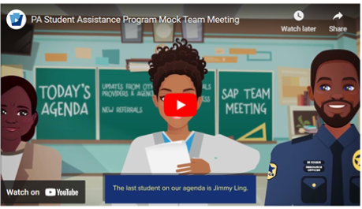
SAP Mock Team Meeting Video
https://youtu.be/qHf6904Ud7E
Notes:
Facilitator note: The SAP Mock Team Video takes about 20-25 minutes to view and debrief. The video highlights many strengths and best practices of effective teams, and an activity sheet has been created for teams to take notes as they view the video on positive things they noticed about each team member. There is a copy of the answer key in the toolkit for the facilitator to use during the debrief
If your team has already viewed the video, you may want to skip this portion if time needs to be adjusted. This video was created in 2024 for the updated SAP training and is a great tool to see updated best practices in action.
Instructions:
Give a copy of the blank activity sheet for this video to each participant. Ask them to write down what each character in the video does well. (Option: you can assign specific characters rather than having everyone write observations for each of the team members in the video.)
Using the answer key, discuss with your team the positive things they noticed from the video.

Slide 5
SAP Team Functioning Survey
Discuss Survey Results:
Are there common areas where strengths exist?
Are there common challenges identified?
Notes:
Say:
This is a helpful tool in reviewing how our team is functioning and gathering feedback from all team members is important.
Everyone should complete the SAP Team Functioning Survey (if not completed in advance.)
Facilitator note:
Complete (if not completed in advance) and review compiled results of the SAP Team Functioning Survey. Review survey responses as a group and discuss areas where multiple team members note strengths and challenges.
This review will help you identify areas that will be discussed in more detail as the maintenance continues.

Slide 6

Overall SAP Team Considerations:
Environment
Does the team have a shared purpose?
How is SAP promoted in your school?
How is SAP perceived by your school community?
Is the SAP team valued in the school by staff?
Does the administration provide ample time and support?
Notes:
Say: One of the considerations for our team's success is its environment.
Facilitator note: Discuss the questions on the screen.
Helpful tips:
Teams that have a shared purpose are often more successful in helping students.
Promoting SAP to all referral sources increases awareness.
Perception of SAP in your school community can impact family engagement.
If the SAP team's work is valued by staff they are more likely to make referrals and assist the team with data collection.
Administrators can ensure your team has adequate time to complete SAP duties and support any other needs your team may have.

Slide 7

Overall SAP Team Considerations:
Organization
Is the workload shared?
Does the team use an agenda?
How does your team ensure confidentiality of SAP all types of information?
Is paperwork organized?
Are more team members needed?
Notes:
Say: Discuss how your team shares the work, how meetings are managed, and how paperwork is organized.
Facilitator note: Discuss the questions on the screen.
Helpful tips:
When teams share the workload it prevents burnout.
Agendas help keep team meeting efficient and on track.
As many teams in the state have begun using electronic files, notes, or agendas - it is important to consider how you ensure confidentiality of all types of SAP materials.
Organization can have a big impact on your PDE4092 data entry and can make this task easier for whoever enters data.
Having sufficient team members reduces individual member's workload.

Slide 8
Evaluating Our SAP Process by Phase
Instructions:
Ensure each team member has a blank copy of the “Evaluating Our SAP Process” document
Each person should use this form to record the strengths and challenges for each phase
At the end of each phase, discuss the best practices and data as a team
Not all concerns may be addressed immediately - we will prioritize towards the end of the maintenance
Notes:
Say:
Using the Evaluating Our SAP Process document, you will note any strengths, concerns, or challenges you identify as you proceed through the maintenance.
Facilitator note:
At the end of maintenance, your team will work together to select a few priorities to address and develop action steps to achieve your desired results.

Slide 9
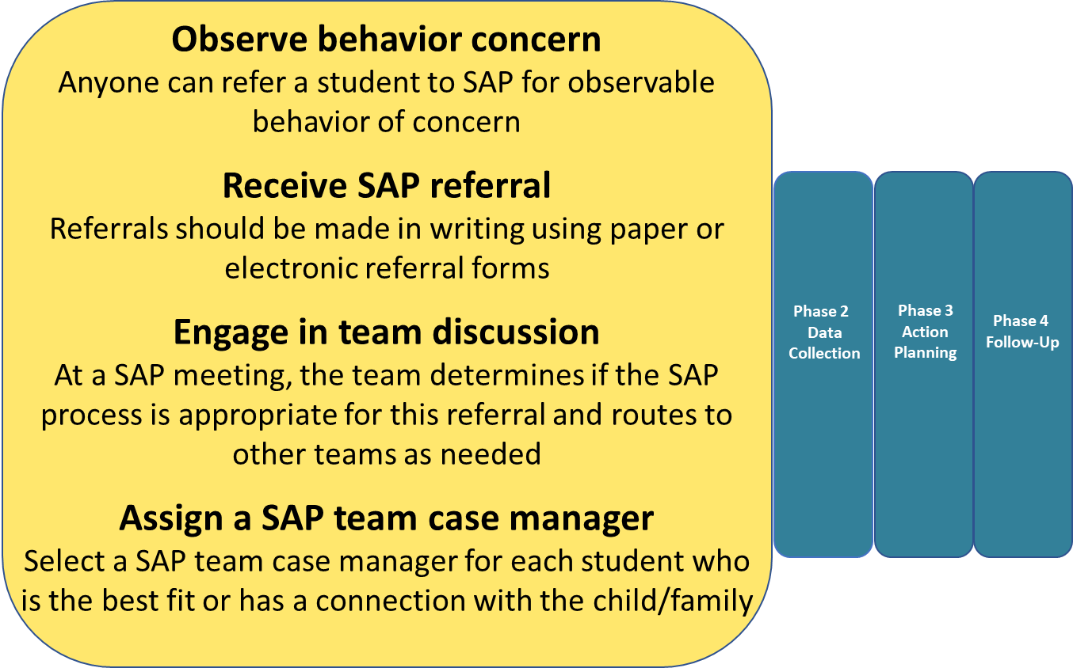
Best Practices - Phase 1: Referral
Notes:
Say: This is the overview slide for Referral phase of SAP process.
Facilitator note: As a team, read each best practice and discuss if there are any questions or concerns.
On the next few slides you will review your team's data relevant to these best practices. You will also review a list of considerations and discuss them as a team.

Slide 10
Phase 1 – Referral
PDE4092 Data Review
Referrals by Gender
Referrals by Grade
Referral Source
Referral Reason
Notes:
Say:
This slide shows the team data we will review in the Referral Phase.
Facilitator note: Remember that you will have copied these graphs from your data template (after entering in your team's 4092 data from the previous year).

Slide 11
Referrals by Gender
PA Safe Schools Online, www.safeschools.pa.gov, PDE4092 data
Notes:
Say:
Is there anything that stands out in our data?
Facilitator note:
Referrals by gender can help ensure your district population is reflected in the SAP referrals your team receives.

Slide 12
Referrals by Grade
PA Safe Schools Online, www.safeschools.pa.gov, PDE4092 data
Notes:
Say: Are all grades represented?
Say: Does the distribution of referrals seem appropriate?
Facilitator note: Discuss whether the data is reflective of your school population.

Slide 13
Referral Source
PA Safe Schools Online, www.safeschools.pa.gov, PDE4092 data
Notes:
Say: Are there any gaps/groups that are not making referrals?
Facilitator note:
If there are groups who do not make many referrals, it may indicate they need more information on SAP. It's important to regularly review when and how to make a referral.

Slide 14
Referral Reason
PA Safe Schools Online, www.safeschools.pa.gov, PDE4092 data
Notes:
Say: As you look at the referral reasons, are there any that seem higher or lower than expected?
Facilitator note:
If a category is lower than expected, discuss how those concerns are being handled and develop ideas for how to resolve

Slide 15
Considerations for Referral Phase
How do you share your referral process with teachers, other staff, families, and students?
Do you have a simple and easily accessible referral form?
Does your staff appropriately identify observable behavior concerns?
What other teams address student concerns in your school?
How do the teams work together, differentiate referrals, and share information?
Does referral data (genders, grades, sources, reasons) reflect your building and student population?
Does your team work together to review ALL referrals and determine appropriate next steps?
Is the SAP team case manager role rotated among team members?
Notes:
Facilitator note:
Review the questions on the slide as a team.
Helpful tip:
It is helpful to share your referral process with staff, families, and students annually.
Referral forms can be located on the school's website for everyone to access and in Google docs for district staff.
When providing training for staff on SAP referral processes, you should include identifying observable behaviors that may indicate a need to make a referral to SAP.
There may be other teams that address other concerns. This is a good time to discuss how teams route referrals to one another, when necessary. Also, teams should work together and share information.
Referrals to SAP should be representative of the district demographics (gender, grades, reasons and from a variety of sources.)
The team works together to process ALL referrals need to have a team discussion to determine next steps.
SAP case management duties should be rotated among SAP team members to ensure sharing the workload.
Say:
This is the last slide for the Referral Phase. Each person should highlight any team strengths and challenges in the Referral phase on their "Evaluating Our SAP Process" document.

Slide 16
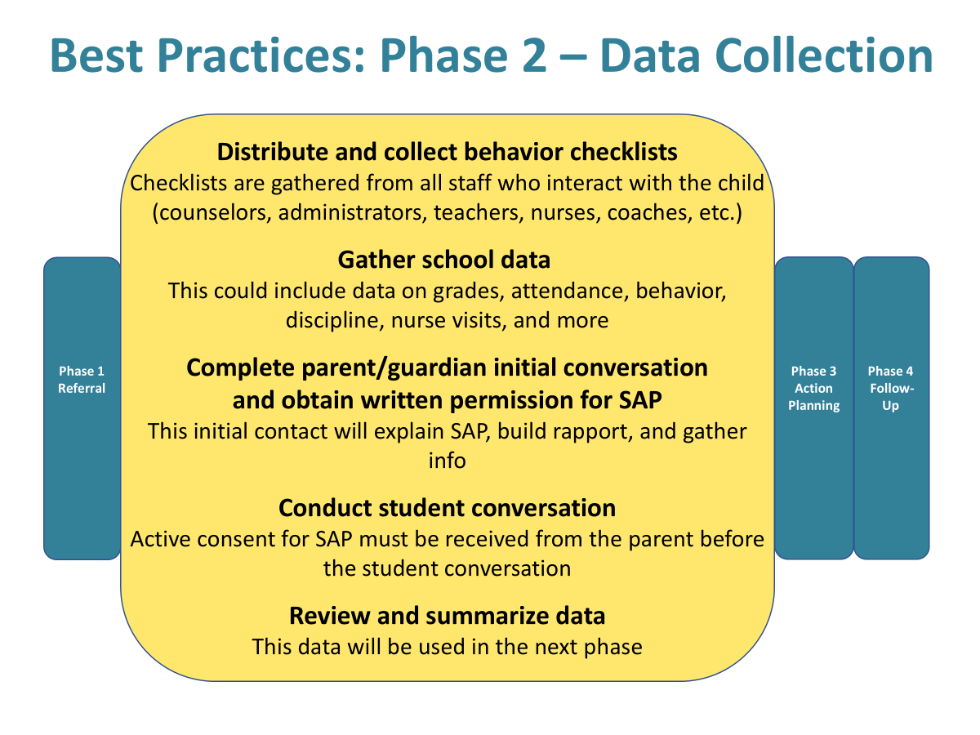
Best Practices - Phase 2: Data Collection
Notes:
Say:
This is the overview slide for the Data Collection phase of SAP process.
Facilitator note:
As a team, read each best practice and discuss if there are any questions or concerns.
On the next few slides you will review your team's data relevant to these best practices. You will also review a list of considerations and discuss them as a team.

Slide 17
Phase 2 – Data Collection
PDE4092 Data Review
School Data Gathered
Behavior Checklist Usage
Parent/Guardian Contact
Written Permission Obtained
Notes:
Say:
This slide shows the team data we will review in the Data Collection Phase.
Facilitator note:
Remember that you will have copied these graphs from your data template (after entering in your team's 4092 data from the previous year).

Slide 18
School Data Gathered
PA Safe Schools Online, www.safeschools.pa.gov, PDE4092 data
Notes:
Say:
Ideally this should be 100% ensuring that data is available on all students to guide decision-making throughout the SAP process.
Facilitator note:
SAP teams need to collect data to make informed recommendations of supports for students.

Slide 19
Behavior Checklist Usage
PA Safe Schools Online, www.safeschools.pa.gov, PDE4092 data
Notes:
Say:
Behavior checklists are a necessary part of the SAP process.
Facilitator note:
You should customize the talking points based on your SAP process: If your team obtains parent permission prior to gathering student behavior checklists, you may not gather these checklists for all referred students.
However, if your team gathers behavior checklists before obtaining parental permission, you should collect behavior checklist data for ALL referrals.
Helpful tip:
There are sample behavior checklists on www.pnsas.org on the Teams page.

Slide 20
Parent/Guardian Contact Initiated
PA Safe Schools Online, www.safeschools.pa.gov, PDE4092 data
Notes:
Say;
It is best practice to contact all parents, even if we are not sure if a student needs SAP support. Parents/guardians may have important information that can help us identify concerns.

Slide 21
Written Permission Obtained
PA Safe Schools Online, www.safeschools.pa.gov, PDE4092 data
Notes:
Say:
Statewide SAP parent consent rates average about 60%. How do we feel our team is doing with parent/guardian permission?
Helpful tip:
You may want to discuss the various areas your team could address to improve your parent permission rates such as: marketing SAP, team member visibility, revising forms, revising processes/procedures, etc.
The Initial Parent Conversation Checklist may help team members become more comfortable with making calls to parents. It also contains helpful information to relay to parents, ensuring that team members are consistent with communicating information and it can help increase parent engagement.
Parent engagement starts long before the SAP process. Your team might want to consider ways to increase parent engagement as a school-wide effort.

Slide 22
Considerations for Data Collection Phase
Do you gather data on every student referred?
Are your behavior checklists easy for staff to fill out?
How is your process working to gather parent/guardian permission?
Are SAP team members conducting student conversations?
How is data stored to ensure the team can view and summarize student data?
Notes:
Facilitator's note:
Review the questions on the slide as a team.
Helpful tips:
Its important to be consistent and gather data for every student referred to SAP.
If your checklists take too long to complete it might be time to update them. You might review the checklists during the "Form Review" portion of the maintenance.
Your process for conducting parent and student conversations may need to be reviewed and updated.
You might consider how you are summarizing and storing your SAP data. It is important to make sure your data is kept in a way that ensures confidentiality.

Slide 23
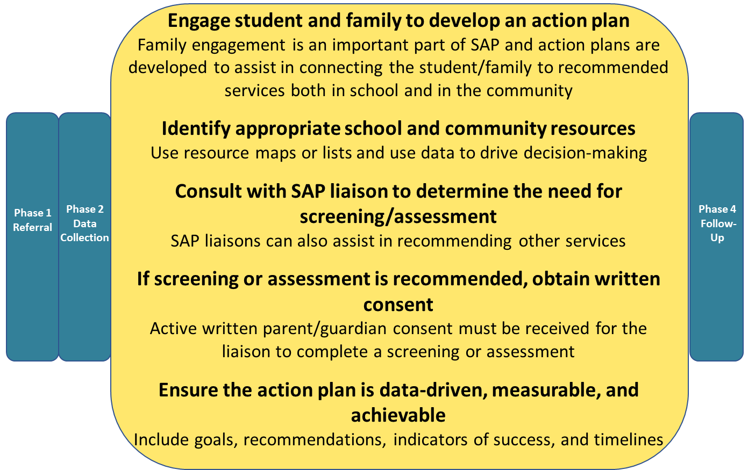
Best Practices - Phase 3: Action Planning
Notes:
Say:
This is the overview slide for the Action Planning phase of SAP process.
Facilitator note:
As a team, read each best practice and discuss if there are any questions or concerns.
On the next few slides you will review your team's data relevant to these best practices.
You will also review a list of considerations and discuss them as a team.
The updated SAP model focuses heavily on this phase of the process.
Helpful tip:
If you are new to action planning, this may be an area where your Regional Coordinator can help you get started.

Slide 24
Phase 3 – Action Planning
PDE4092 Data Review
School Services Recommended
Schol Services Accessed
Community Services Recommended
Community Services Accessed
Notes:
Say:
This slide shows the team data we will review in the Action Planning Phase.
Facilitator note:
Remember that you will have copied these graphs from your data template (after entering in your team's 4092 data from the previous year).

Slide 25
School Services Recommended
PA Safe Schools Online, www.safeschools.pa.gov, PDE4092 data
Notes:
Say:
The first set of data that we will analyze is recommended school services. Most students referred to SAP could benefit from additional support during the school day.
Facilitator note:
Review the primary school supports recommended and identify any areas that are high or low.

Slide 26
School Services Accessed
PA Safe Schools Online, www.safeschools.pa.gov, PDE4092 data
Notes:
Say:
This data slide shows you how often students are accessing the school services and supports the team has recommended. The statewide average for accessing supports is 87.5% and 3.4% of cases across the state had no school supports recommended.
Facilitator note:
If you notice that your access rates are considerably lower, you might discuss with your team any barriers that may exist to students and families accessing school supports.

Slide 27

Recommended School Supports
What supports are you recommending for students through SAP?
What additional school supports are available that the SAP team could recommend?
Notes:
Say:
What types of school supports do we typically recommend for SAP cases? Are there other informal supports we could access but don't think of for SAP?
Helpful tip:
If your team's data indicates that often "no school services are recommended", you might consider how your team can utilize additional available school supports.
Facilitator note:
Sometimes teams don't think to recommend student supports such as Check In/ Check Out, lunch bunch groups, or other mentoring/check ins.
If you are struggling to identify school supports, it might be a good idea for your team to engage in resource mapping.
Helpful tip:
Contact your regional coordinator for hep with resource mapping school supports.

Slide 28
Community Services Recommended
PA Safe Schools Online, www.safeschools.pa.gov, PDE4092 data
Notes:
Say:
This slide shows what community supports our SAP team recommends for students.
Facilitator note:
If your team is often not recommending community supports, you might have discussions with your team about what services are available to recommend. Your SAP liaison can help your team identify community services that exist in your area.
Depending on the type of SAP liaison you have on your team, some of these categories may be blank. Some schools have separate liaisons for mental health and drug and alcohol, while others have a behavioral health SAP liaison who is cross-trained in both areas.
If you are not sure which type of liaison you have, reach out to the liaison for clarification. Some schools may not have access to a SAP liaison.

Slide 29
Community Services Accessed
PA Safe Schools Online, www.safeschools.pa.gov, PDE4092 data
Notes:
Say:
This data slide shows how often students are accessing the community services and supports the team has recommended. The state average for accessing community supports is 59.6% and 33.1% had no community supports recommended.
Facilitator note:
There are many factors that can impact access rates for community services like wait-lists, insurance, eligibility, and transportation. If you are noticing a decrease in community service access rates, you may want to discuss what is affecting your students' access.

Slide 30
Student SAP Action Plan
A structured plan that identifies appropriate school and/or community supports and services for the referred student​
Developed collaboratively with the student and family​
Developed based on data (both strengths and concerns) gathered throughout the SAP process​
A "living document" that is monitored and updated as needed
Notes:
Say:
PNSAS recommends supports for SAP cases be documented through a SAP Action Plan. Action Plans are used to identify strengths of the student and family, prioritize identified concerns, and track and manage goals for the student.
The next several slides will review the action plan in depth.
Facilitator note:
Review the pieces of the action plan and identify any areas that your team feels may need improvement.
The action plan is a living document and can be changed as needed.

Slide 31
Key Components of the Action Plan
Background and basic summary of referral (e.g., referral reason, strengths and concerns, prior/ongoing supports, etc.)​
Recommended school and/or community interventions and supports​
Goal(s) and indicator(s) of progress or success​
Action steps for each goal​
Staff responsible​
Timelines​
Check-in timelines and progress measures
Notes:
Say:
This slide reviews the key components of the action plan.
Facilitator note:
You will review these components and compare with your school's action plan to determine if it has all of the components listed here.

Slide 32
Considerations for Developing the Action Plan
Look for opportunities to promote and foster resilience ​
Partner with the student and family to address cultural factors, preferences, and priorities​
Consider what strategies have been tried previously and their outcomes​
Check the availability of school and community resources​
Ensure that the action plan is measurable and data-driven ​
Use the plan as an accountability tool
Notes:
Say:
This slide shows some things to consider as we create action plans.
Facilitator note:
Review the points on the slide with your team.
Helpful tips:
It may be helpful to consider student and parent input when creating your action plan.
Your SAP liaison may be helpful in checking availability of community resources.
Action plans help define what success looks like for the student and define everyone's role in the plan.

Slide 33
Sample Action Plan
Goal #1: Ex. Student will be on time for all classes 4 out of 5 days per week for the next marking period | Goal #1: Ex. Student will be on time for all classes 4 out of 5 days per week for the next marking period | Goal #1: Ex. Student will be on time for all classes 4 out of 5 days per week for the next marking period | Goal #1: Ex. Student will be on time for all classes 4 out of 5 days per week for the next marking period | Goal #1: Ex. Student will be on time for all classes 4 out of 5 days per week for the next marking period | Goal #1: Ex. Student will be on time for all classes 4 out of 5 days per week for the next marking period
Action Steps | Resources | Responsibilities (Who?) | Timeline | SAP Team Follow-Up/ Check-In | Progress Measures
Ex. Student will connect via Check In/Check Out daily | Ex. School staff member assigned | Ex. Teacher will set up times and routine with student | Ex. Start daily checkins within 2 weeks (by 6/27) | Ex. SAP Case Manager will check in 7/1 | Ex. Check ins happening daily; student engaged; decrease in disciplinary referrals
Notes:
Say:
On this slide you will see a screen shot of the goal and action step section of the sample PNSAS action plan.
Facilitator note:
How does this compare to your team's action plan?
If your team does not have an action plan, feel free to customize this one to your team's needs.

Slide 34
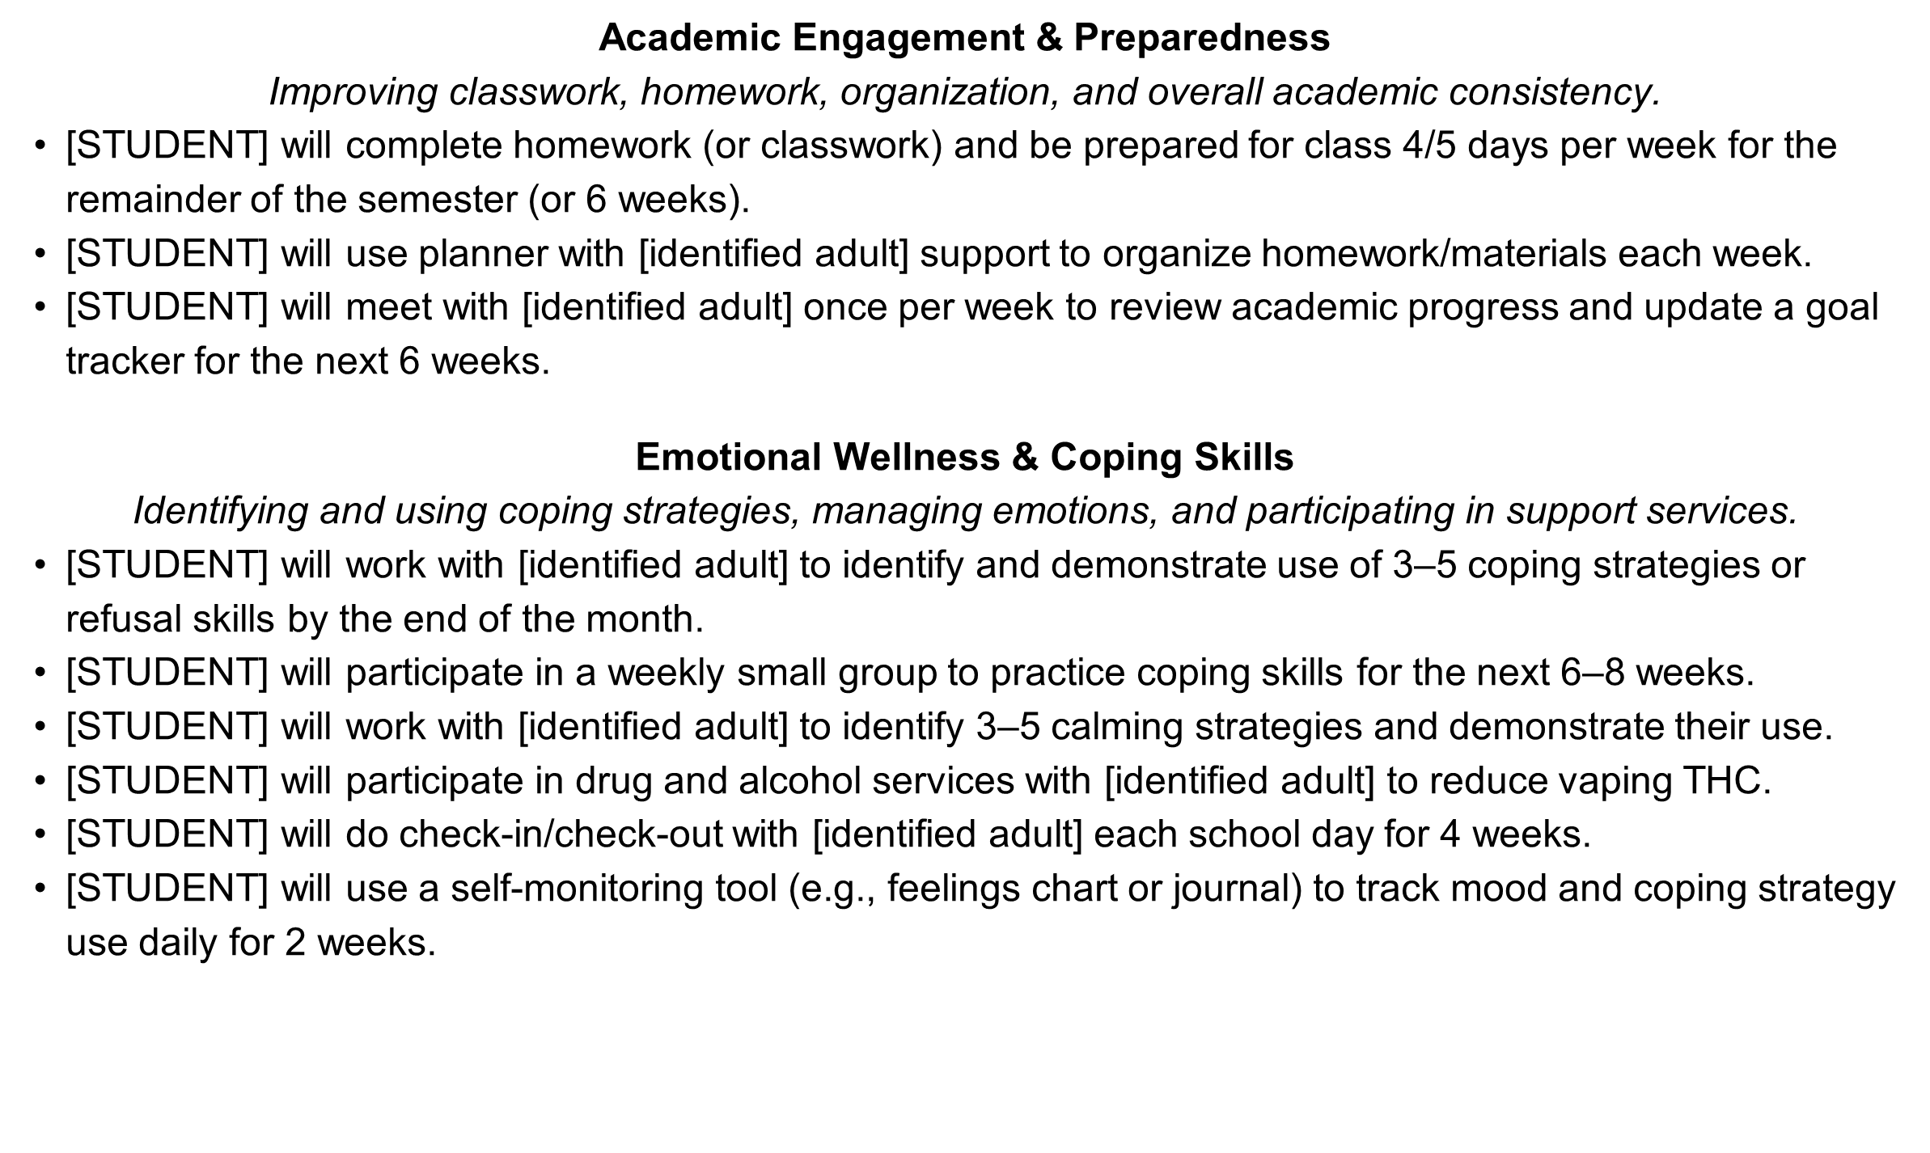
Sample Goals for SAP Action Plans
Notes:
Say:
PNSAS has developed a sample goal list for teams to use to assist them in choosing/writing goals for their students.
Facilitator note:
As a team, review the sample goals together. This slide contains goals for academic engagement and preparation and emotional wellness and coping skills.
You might consider creating some of your own goals to use as a sample goal list.

Slide 35
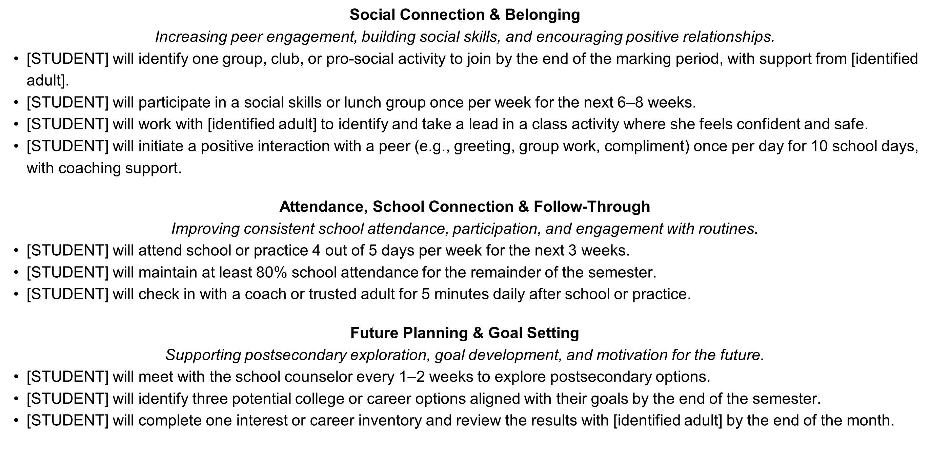
More Sample Goals for SAP Action Plans
Notes:
Say:
This slide contains sample goals in the areas of social connection and belonging, attendance, school connection and follow-through, and future planning and goal setting.
Facilitator note:
Just as you did with the previous slide, you will review the goals together.
Remember that these are just ideas, and that your team will need to ensure that the goals you select are individualized for your students.

Slide 36
Considerations for Action Planning Phase
Do you maintain lists of resources and supports in the school and/or community?
Do you consider the student/family wishes when selecting supports to recommend?
Do you recommend both school and community supports for students?
Are students accessing the recommended supports?
Do you utilize your liaison to help determine if a screening or assessment is needed and recommend supports?
Does your team use an action plan or have a process to document recommended supports, action steps, timelines, and progress measures?
Notes:
Facilitator note:
Review the questions on the slide as a team.
Helpful tips:
You will discuss with your team how you currently maintain lists of resources to recommend and whether a future resource mapping session might be necessary.
It is best practice for your team to incorporate the student and family preferences into the action plan (or selecting resources).
It is important to recommend both school and community resources. School services should be considered even when a student is receiving community supports like outpatient counseling.
If there are common reasons students are not accessing supports, it may be helpful to brainstorm ways to address these barriers.
Liaisons can be a helpful resource in determining the need for screening/ assessment and may also have ideas for community supports to recommend.
Formalized action plans are helpful to document supports and action steps, as well as how your team will measure progress.

Slide 37
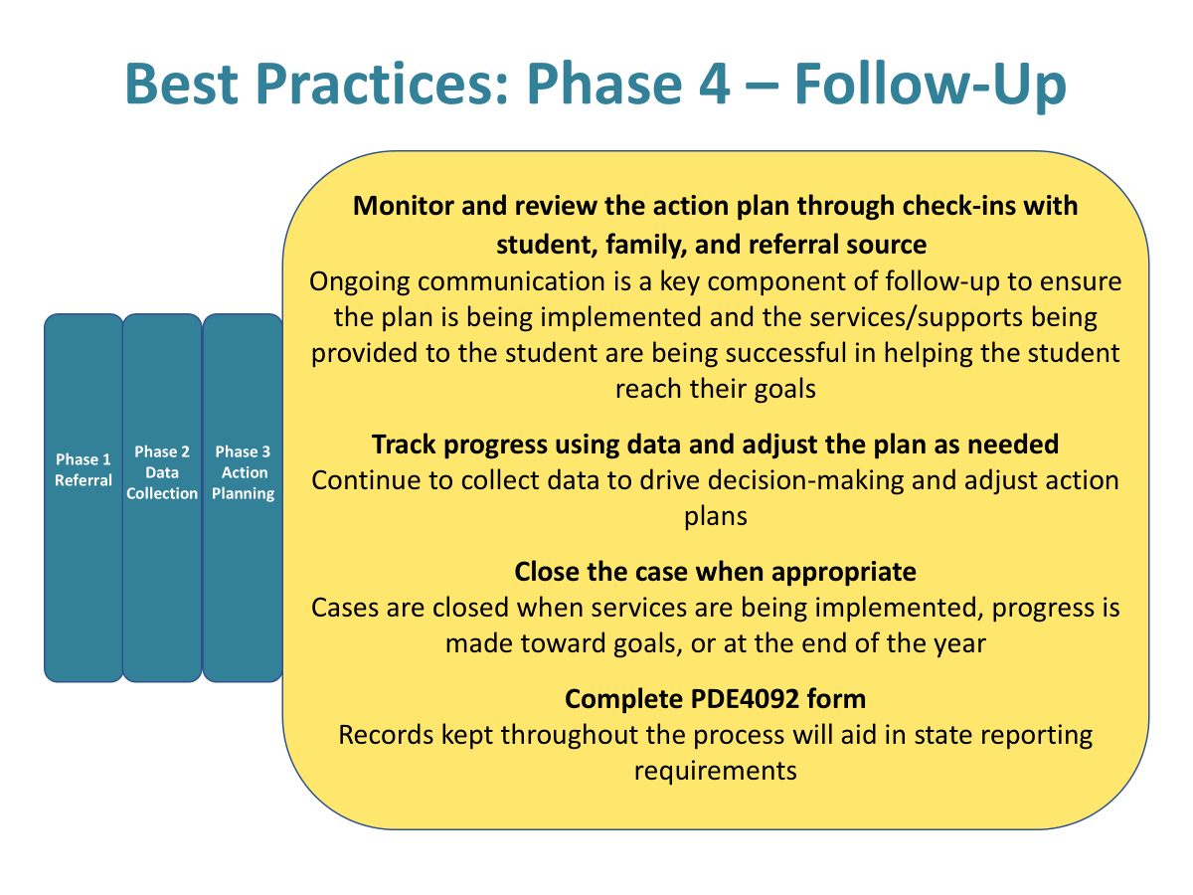
Best Practices - Phase 4: Follow-Up
Notes:
Say:
This is an overview slide of Phase 4- Follow-Up.
Facilitator's note:
As a team, read each best practice and discuss if there are any questions or concerns.
On the next few slides you will review your team's data relevant to these best practices.
You will also review a list of considerations and discuss them as a team.

Slide 38
Progress Monitoring and Updating the Action Plan
Monitor the indicators of progress​
Track the data sources outlined​
If the data indicates:​
Substantial progress → Continue to monitor ​
Partial progress → Consider revising portions of the plan​
Little or no progress → Revise the plan
Notes:
Say:
Let's review how we monitor and track process for our students.
Facilitator note:
Review the points on the slide and determine how well your team is using data to guide the action plan.
Helpful tips:
Following up with referral sources, parents, and the students can help the team make decisions about when to monitor, revise, or close the case.

Slide 39
Considerations for
Follow-Up Phase
Do you follow-up with students and families about whether recommended supports have been accessed?
Do you check in with staff, students, family, and the referral source to monitor progress?
Do you amend your recommended supports as needed dependent on progress?
How does your team determine when to close a SAP case?
Is your SAP data organized in a way that makes it easy to complete the PDE 4092?
Notes:
Facilitator's note:
Review the questions on the slide as a team.
Helpful tips:
It is helpful to follow up with students and families to ensure that recommended services are accessed.
Make adjustments to the action plan as needed, based on progress data.
Best practice is to close cases when services are in place, progress is being made, and goals are being achieved.
Organize your data in a way that makes it easy to complete the 4092 report, such as completing sections of the printed document along the way or entering data in the system throughout the year.

Slide 40

Self-Care
How can we reduce burnout among team members?
Notes:
Say:
Self-care is important for the health of our team.
Facilitator note:
Discuss ways that your team members are engaging in self-care to reduce burnout.
If you find that your team is not engaging in self-care, you might talk about ways that your team can incorporate self-care strategies together.
Helpful tips:
Ensure members can take a break from SAP, if needed. Team members should have the option to rotate on and off the team to help to keep the team healthy.

Slide 41

Compassion Resilience Toolkit
Compassion Resilience
Explore ways to build resilience and strategies for wellness using the resource below.
Notes:
Say:
We are going to spend some time working on self-care and resilience as a team. We are going to complete a module from the Compassion Resilience Toolkit.
Facilitation note:
Download the Compassion Resilience Toolkit ahead of time if you are planning to use it during maintenance.
Navigate to the "How to Implement" tab on the left to get started.
Helpful tips:
You will want to become familiar with the contents of the website and which pieces you plan to use.

Slide 42
Forms Review
When was the last time you reviewed and updated your SAP forms?
SAP brochure/marketing materials
Referral form
Initial SAP Parent Consent
Behavior Checklists
Action Plan
Sample forms are available on the PNSAS website on the Teams page.
Notes:
Say:
We are going to take some time to review all of the forms we use and determine what needs to be updated.
Facilitator note:
Review each form the team uses, starting with the ones your team feels are most important or most in need of updating.
Helpful tips:
PNSAS has many sample forms on the website that are available. Feel free to customize these forms to meet your teams needs. You can use them as a guide to determine if your forms have all of the best practice components.

Slide 43
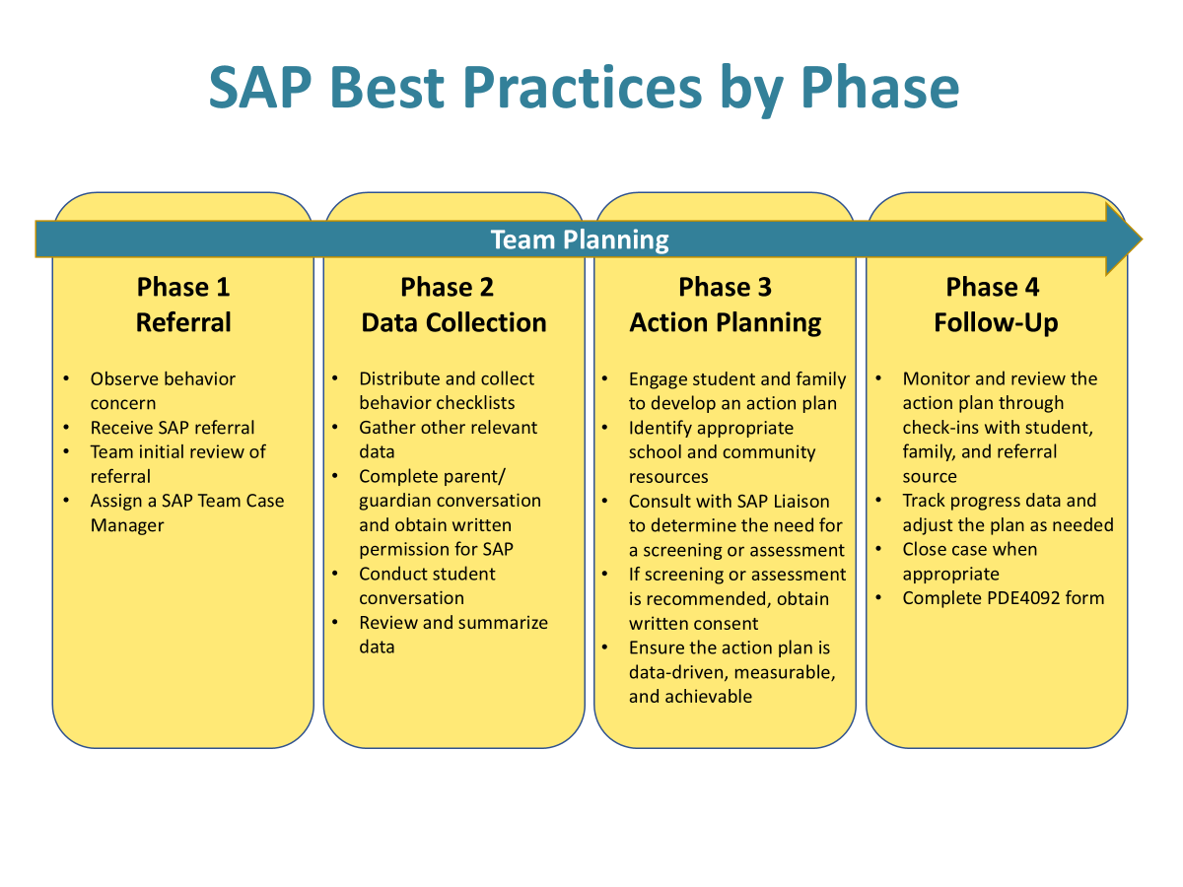
SAP Best Practices by Phase
Notes:
Say:
This is an overview of the best practices by phase for the new SAP model.
Facilitator note:
Briefly review each of the four phases of SAP with your team and answer any lingering questions that your team members might have.
Helpful tips:
This document may be a helpful handout to provide during team maintenance.
If any questions or concerns arise during your maintenance, reach out to your PNSAS Regional Coordinator for help.

Slide 44
Evaluating Our SAP Process
Using your worksheet, note any areas of strengths or concerns for each phase:
Phase 1: Referral
Phase 2: Data Collection
Phase 3: Action Planning
Phase 4: Follow-Up
Notes:
Say:
Let's take a few minutes to review the notes that you have been taking as we reviewed each phase.

Slide 45

Strengths
What team strengths did you identify?
Celebrate your accomplishments!
Notes:
Say:
It's important to celebrate the things our team is doing well! What did you identify as areas of strengths?

Slide 46

Prioritize Concerns and
Plan Next Steps
Review all the challenges or barriers your team identified through the survey and reviewing best practices and data in each phase
Using your worksheet, note areas you feel you can impact in the next year
What 2-3 priorities does your team want to focus on changing?
What steps will be taken and who needs to be involved?
Determine how you will monitor progress
Notes:
Say:
Now that we have identified all of the challenges and barriers, let's take a few minutes to identify the top 2-3 priorities we will work on first.
Facilitator note:
After discussion, have the team note the top priorities on the last page of "Evaluating our SAP Process." Make sure that the team identifies the action steps that will be taken, by who, and when.
Helpful tips:
Start with just 2-3 priorities. Once they are accomplished, your team can choose to address other items.

Slide 47
Thanks for participating in SAP Team Maintenance!
Notes:
Say:
Thank you for participating in our team maintenance. If you have any questions or suggestions, please feel free to bring them to me or put them on our next team meeting agenda.

